Slide 1
PYTHON PROJECT:
Attempting to Calculate the Mass of a Supermassive Black Hole
By: Elaina Sadler

Slide 2
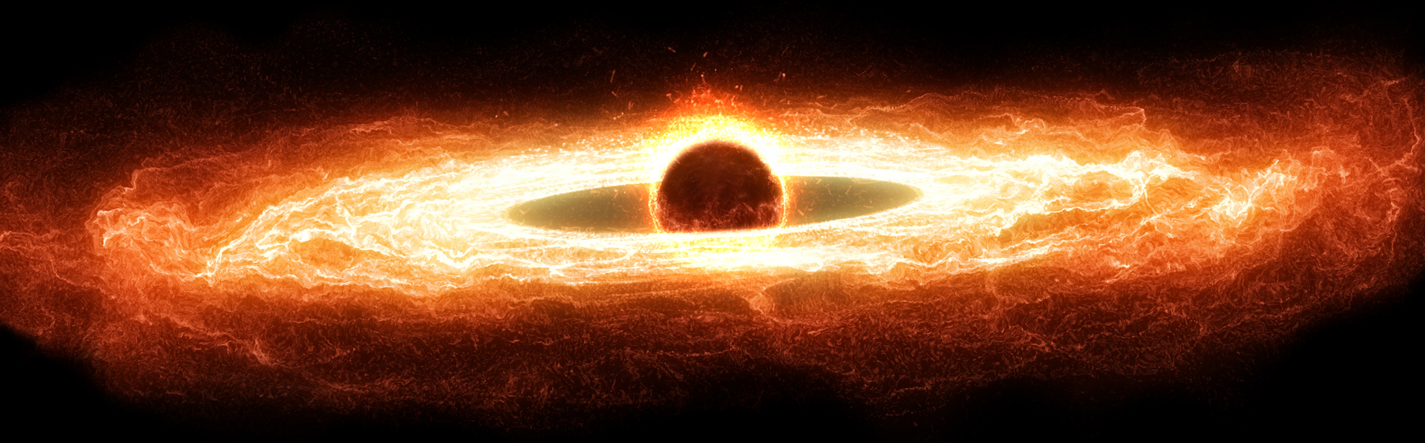
What is a Supermassive Black Hole?
Massive astronomical object where gravity is so strong that even light cannot escape
Mass ranging from hundreds of thousands to billions of times that of our Sun
Typically found at the center of large galaxies, including our Milky Way:
Sagittarius A*

Slide 3
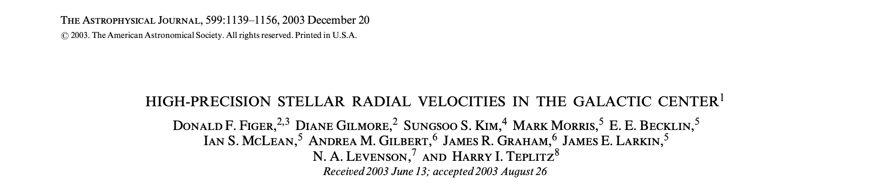
Data I Used:
Paper took data from 85 cool stars from the central parsec of the Galaxy
The data has much smaller errors than than those previously obtained with proper-motion or other radial velocity measurements
Some of the data had already been reduced to include only the stars with high-quality spectra as well as only the cool-star orbits
Said that there were “no large systematic errors in the absolute velocity calibration”
No extra filtering needed

Slide 4
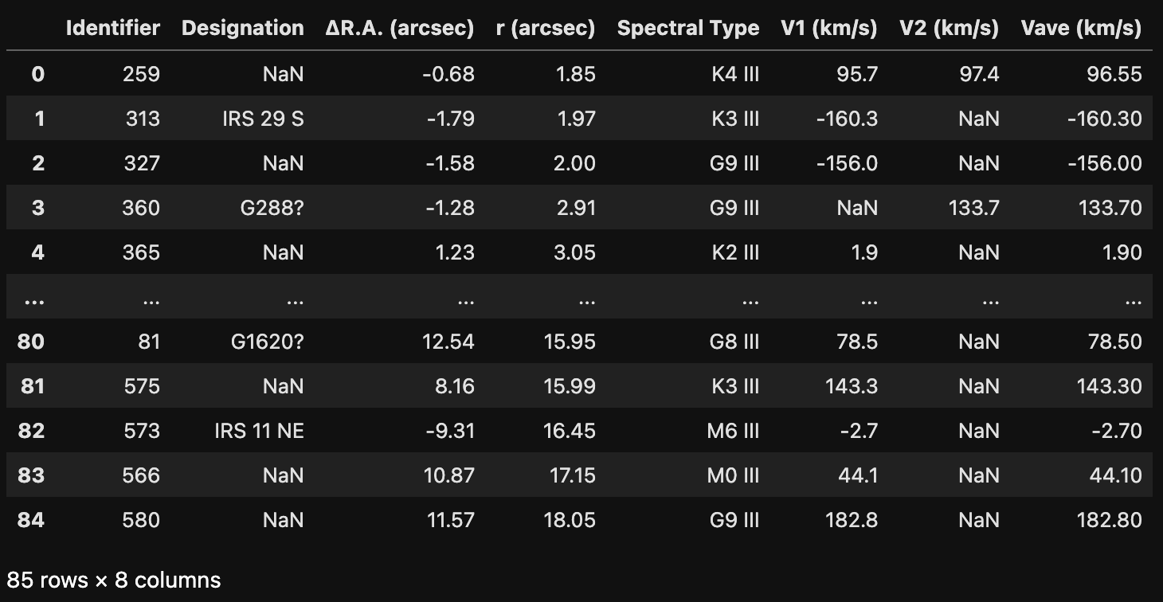
Data Provided from Source:
Notes:
Data table provided by paper
Had to add a column for velocity squared and r in km for units to cancel out

Slide 5
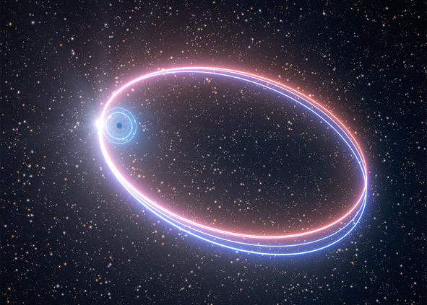
Kepler’s Third Law
Equation: M = (rv²)/G
M = Mass of Black Hole
r = Orbital Radius of Star
v² = Orbital Velocity of Star
G = Gravitational Constant
M = (v²/G)r
2. M = (r/G)v²
3. v² = MG/r

Slide 6
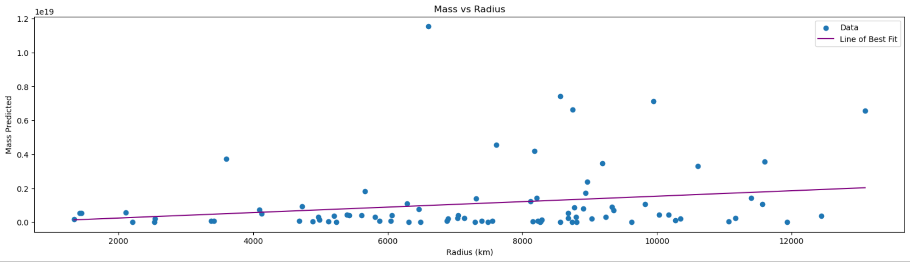
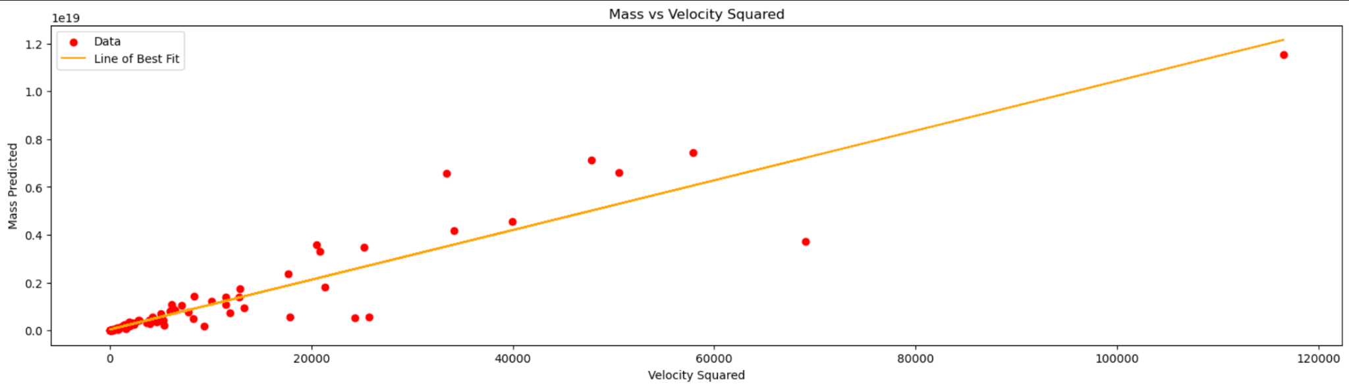
Notes:
Didn’t provide the answer we wanted since they provided the average velocity or radius

Slide 7
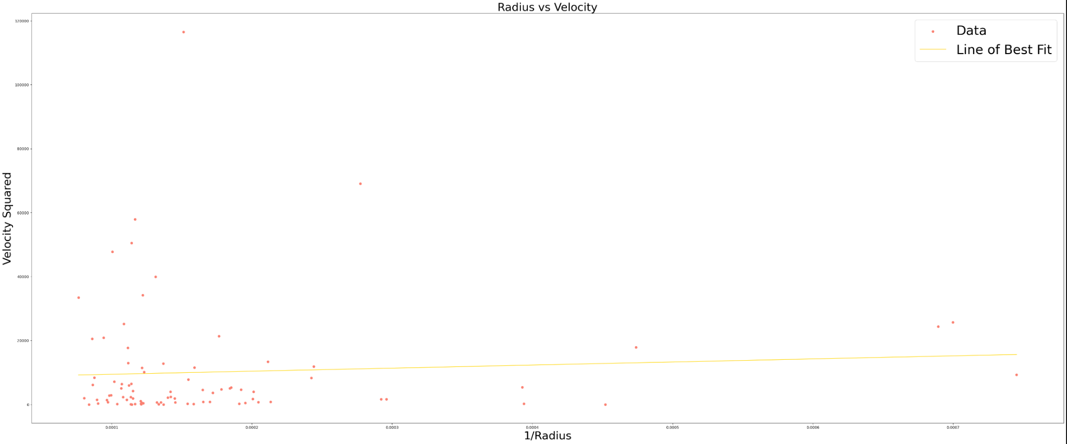
Final Graph: v² = MG(1/r)
1/Radius (x Data), Velocity Squared (y Data)
Slope = M(G) = 9601975.416076401
M = Mass of Supermassive Black Hole = 1.4386e26 kg

